Slide 1
Stock Market Performance Overview
Prepared by : Saurabh Mishra

Slide 2
Problem Statement
How to collect and refresh live stock data using Python (yfinance)
How to clean and preprocess stock market datasets
How to analyze sector and index performance for selected symbols
How to visualize stock market insights through interactive dashboards
How to generate SQL-based insights for business decisions

Slide 3
Objective
The objective of this analysis is to evaluate and monitor the performance of the stock market by collecting live stock data, cleaning and preprocessing it, and analyzing trends across sectors and indices. The study aims to generate actionable insights through interactive visualizations and SQL-based queries to support informed business and investment decisions. Additionally, it focuses on automating the data refresh process to maintain up-to-date market information for timely analysis.

Slide 4
Data Description
Source: python Yfinance
Rows: based on stocks
Columns: Requirements
Key Features: Date, High, Low, Open, Symbol, Volume

Slide 5
Methodology
Tools: Python (Pandas, pymysql, yfinance), MySQL, Power BI
Steps: Fetch data Data Cleaning Exploratory Data Analysis Visualization Insights Recommendations Conclusion Future Scope

Slide 6
Exploratory Data Analysis (EDA)
Trend analysis over time
How open Price influence
Volume analysis by stock
High vs Low indicator

Slide 7
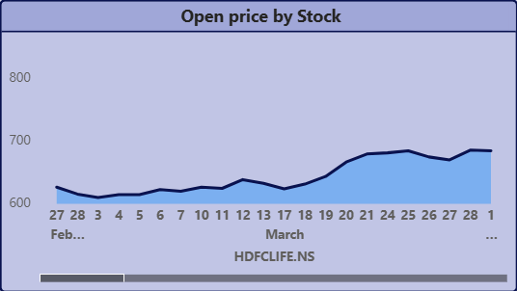
Exploratory Data Analysis (EDA)
Trend analysis over time
How open Price influence
Volume analysis by stock
High vs Low indicator

Slide 8
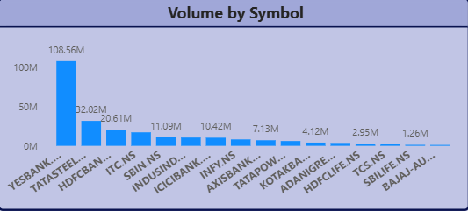

Slide 9
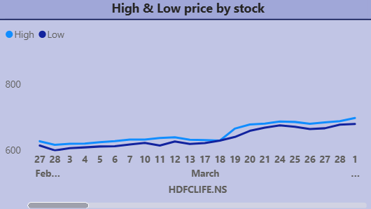

Slide 10
Business Insights
Certain stocks or sectors consistently show upward trends.
Volatility linked to market news or macroeconomic factors.
Open patterns for volatility.
High-Low spreads indicate risk.
Volume spikes show investor sentiment shifts.

Slide 11
Recommendations
Focus on high-performing sectors for growth portfolios.
Use low-volatility stocks for stable income.
Monitor High-Low spreads & volumes.
Diversify across sectors.
Set up alerts for price/volume spikes.

Slide 12
Conclusion
The analysis provides a clear picture of stock market behavior...

Slide 13
Future Scope
Incorporate ML for stock prediction & sector forecasting.
Apply sentiment analysis from news/social media.
Automated portfolio diversification recommendations.
Suggest buy/sell points using technical indicators.
Predictive alerts & notifications for investors.

Slide 14
Thank You
Q&A

